Slide 1
Hands-on: train & Inference CNN on Intel® AI DevCloud
Chris Ma
Technical Solution Engineer 18 Mar 2019

Slide 2
Agenda
Introduction to Intel® DevCloud
How to access to Intel® DevCloud
How to run / track / check / delete a job on Intel® DevCloud
Demo 1
- Train & inference Cifar-10 dataset via QSUB in interactive mode (Sources by Prof. Aven)
Demo 2
- Train & inference breeds dataset via QSUB in normal mode

Slide 3
Intel® AI DevCloud
Broad community of developers, data scientists, students, professors and startups
Intel® Xeon® Scalable Processors(Intel® Xeon® Gold 6128 CPU @ 3.40GHz 24 cores with 2-way hyper-threading, 192 GB RAM (DDR4), 200 GB of file storage
Intel® Neon™, Intel® TensorFlow*, Intel® Caffe*, Intel® Theano*, Intel® Python* 2.7 and 3.6 including NumPy, SciPy, pandas, scikit-learn, Jupyter, matplotlib, mpi4py, etc…
4 weeks of initial access, with extension based upon project needs
Technical support via Intel® AI Academy Support Community
Access Request: https://software.intel.com/ai-academy/tools/devcloud

Slide 4
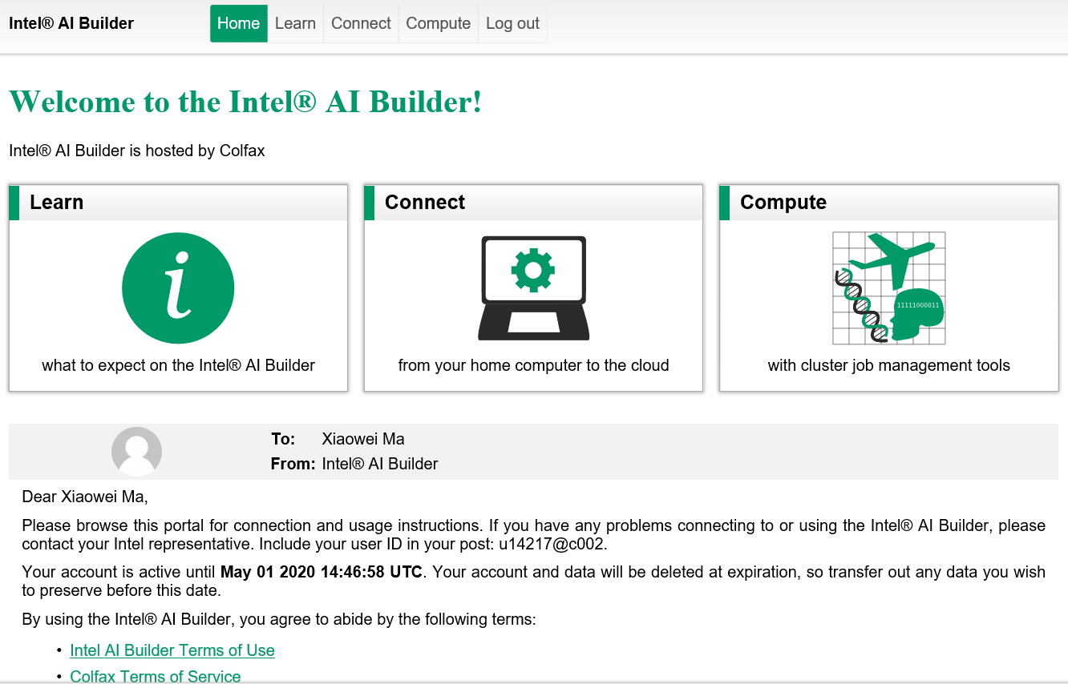
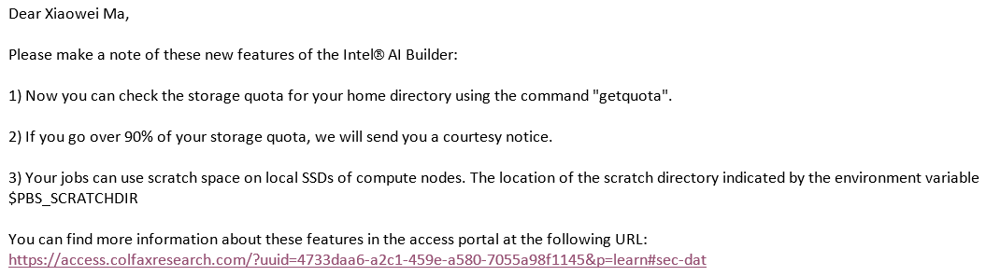
Welcome to DevCloud
Click

Slide 5
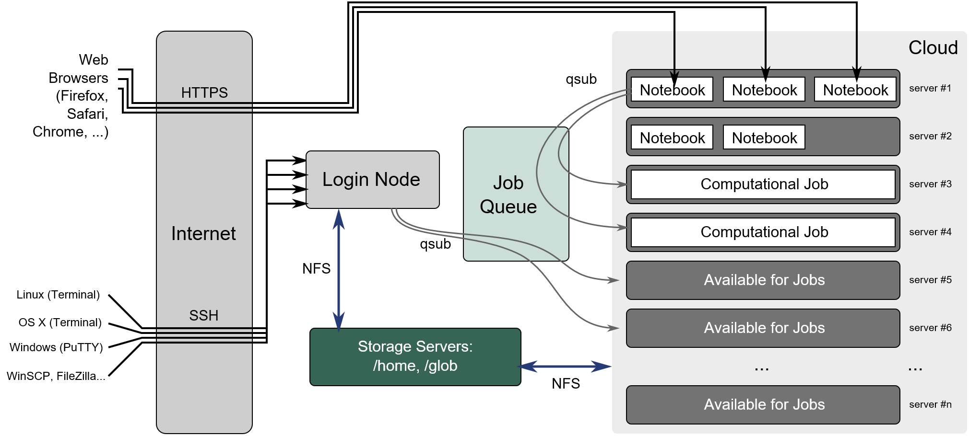
Introduction to DevCloud architecture

Slide 6
Access to DevCloud
Linux / Mac / Linux on Windows
Download and save the Linux Access Key
Update ~/.ssh/config
Set correct restrictive permissions on the private SSH: $ chmod 600
If you are using Putty From Windows
Download the ssh client PuTTY – make sure to use the 64bit MSI installer.
Download and save Windows access key
Right click on the downloaded key and choose “Load into Pageant”

Slide 7
Access to DevCloud
Linux / Mac / Linux on Windows
Download and save the Linux Access Key
Update ~/.ssh/config
Set correct restrictive permissions on the private SSH → chmod 600
If you are using Putty From Windows
Download the ssh client PuTTY – make sure to use the 64bit MSI installer.
Download and save Windows access key
Right click on the downloaded key and choose “Load into Pageant”
Quick steps:
1. Edit addkey.sh
2. Run addkey.sh

Slide 8
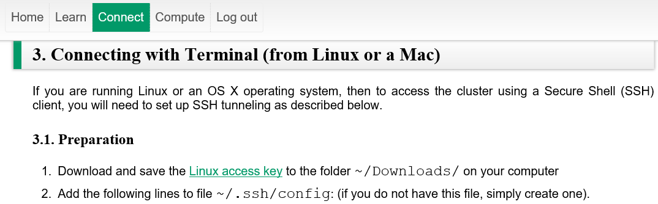
Add Key access to Devcloud
Step 1
Add key
1
2

Slide 9
Add Key access to Devcloud
<file addkey.sh>
mkdir ~/.ssh
touch ~/.ssh/config
echo "Host colfax" > ~/.ssh/config
echo "User uxxxx" >> ~/.ssh/config
echo "IdentityFile ~/Downloads/colfax-access-key-xxxx" >> ~/.ssh/config # Make sure your key is under ~/Download/
echo "ProxyCommand ssh -T -i ~/Downloads/colfax-access-key-xxxx guest@cluster.colfaxresearch.com" >> ~/.ssh/config
chmod 600 ~/Downloads/colfax-access-key-xxxx
chmod 600 ~/.ssh/config
3
Replace xxxx with your access key number
4
Run addkey.sh script
$ sh addkey.sh

Slide 10
Access to DevCloud
Connect to the login node
$ ssh colfax # Notice it is NOT compute node
Step 2
Connect
You’re here!

Slide 11
Log in Compute Node
Use qsub -I to log in the compute node in interactive mode
$ qsub -l walltime=24:00:00 -I
Step 3
Login
Now You’re here!

Slide 12
Install dependencies
Step 4
Setup environment
Virtual environment
$ conda create -n <tf> -c intel pip numpy … # Create virtual environment (VE)
$ source activate tf # Activate VE
(tf) conda install -c intel tensorflow-mkl # Install Intel Tensorflow in VE
(tf) pip install keras # Install Keras in VE
(tf) source deactivate # Deactivate VE
Local environment
$ pip install --user tensorflow # Install Tensorflow in local
$ pip install --user keras # Install Keras in local

Slide 13
Upload Scripts & Data set
Step 5
Upload
Linux or Mac
Use scp command to transfer files
Windows
Use WinSCP tool to transfer files
$ scp -r <src> colfax:<des>
E.g.: $ scp –r data/breeds colfax:~/data/
! Note that scripts and data set need uploaded from local instead of login node

Slide 14
Demo 1
Train & inference Cifar-10 via QSUB in interactive mode (Sources by Prof. Aven)

Slide 15
RUN a Job via Qsub in normal mode
Use qsub -l <param1> -l <param2> <script file> to launch a queued job
$ qsub -l nodes=<number of required nodes>:ppn=<number of required CPU cores> -l walltime=<xx:xx:xx>
<script file> -k oe
Eg.: $ qsub -l nodes=1:ppn=1 -l walltime=24:00:00 main -k oe
Output and error file
Step 6
qsub …

Slide 16
Run Demo 2
Prepare environment and submit a job
$ sh prepare_env_tf
$ sh qsub_tf
Output files under HOME user path
Step 7
Final check!
<file qsub_tf>
qsub -l nodes=1:ppn=1 script_PetsHandsOnExcercise -k oe
<file script_PetsHandsOnExcercise.o2019>
output file
Check:
$ view script_PetsHandsOnExcercise.o2019
$ sh qsub_tf
<file script_PetsHandsOnExcercise.e2019>
error file
Check:
$ view script_PetsHandsOnExcercise.e2019

Slide 17
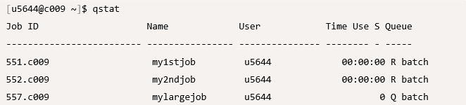
How to track status…
Use qstat to check status of submitted job
Q: Queued
R: Run
C: Completed*
…

Slide 18
Delete Jobs
Use qdel <job id> to remove submitted job
Use qdel all to cancel all running and queued jobs

Slide 19
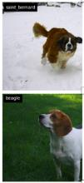
Training & test breeds workflow
Problem Statement
State an issue to resolve
Get Data
Adopt dataset
Clean Data
Clean, normalize, split, augment, etc.…
Train
Test
37 breeds — learn to tell them apart
Test local sample
British Shorthair
Wheaten Terrier
?
Picture source: Stanford ImageNetDogs dataset
http://vision.stanford.edu/aditya86/ImageNetDogs/main.html

Slide 20
Training & test breeds workflow
Problem Statement
State an issue to resolve
Get Data
Adopt dataset
Clean Data
Clean, normalize, split, augment, etc.…
Train
Test
37 breeds — learn to tell them apart
Test local sample
prepare_env_tf
cp /data/breeds ~/
…

Slide 21
Training & test breeds workflow
Problem Statement
State an issue to resolve
Get Data
Adopt dataset
Clean Data
Clean, normalize, split, augment, etc.…
Train
Test
37 breeds — learn to tell them apart
Test local sample
prepare_env_tf
clean_data.py

Slide 22
Training & test breeds workflow
Problem Statement
State an issue to resolve
Get Data
Adopt dataset
Clean Data
Clean, normalize, split, augment, etc.…
Train
Test
37 breeds — learn to tell them apart
Test local sample
script_PetsHandsOnExcercise
$ train_image_classifier.py --train_dir=…

Slide 23
Training & test breeds workflow
Problem Statement
State an issue to resolve
Get Data
Adopt dataset
Clean Data
Clean, normalize, split, augment, etc.…
Train
Test
37 breeds — learn to tell them apart
Test local sample
script_PetsHandsOnExcercise
$ eval_image_classifier.py --dataset_dir=…

Slide 24
DEVCLOUD FAQ
The bottom of here

Slide 25
Thanks!! Q & A

